Slide 1
A Reinforcement Learning Agent to Play Risk
Alex Goodall and Jon Barnes-Nunn

Slide 2
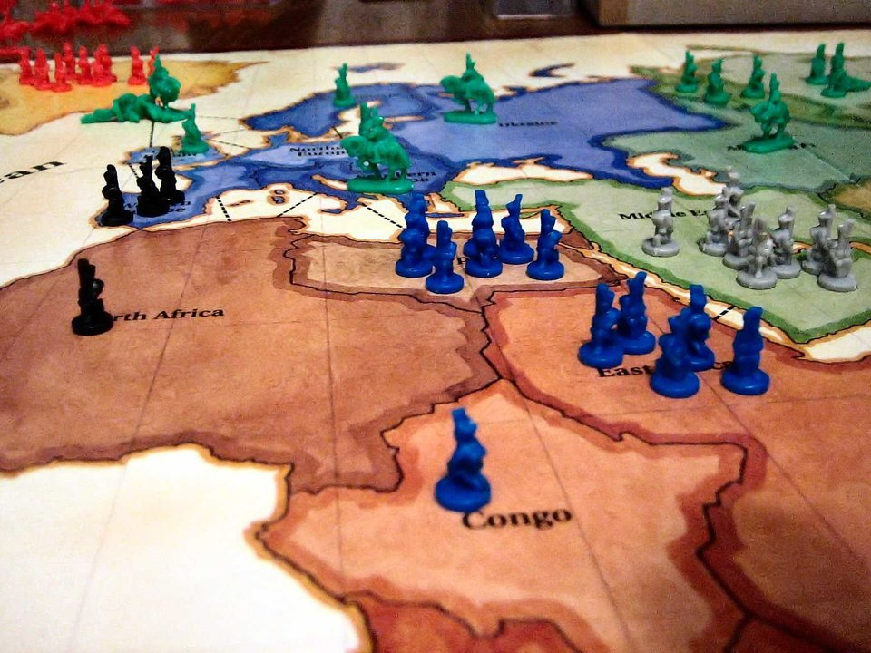
What is Risk?
Aim: Capture all Territories
Three phase turns:
  Reinforce
    New units based on current territories
  Attack
    Can battle other players for their territory
  Fortify
    Move troops to different owned territories

Slide 3
Simplification
Only use half of the board – reduce initial troops accordingly
Remove fortification phase
No retreat after attacking, attack with max units
Exactly 3 players
No attack cards or objectives
No max number of units

Slide 4
Random Agent
Reinforcement
  Each unit is added to a random owned territory
Attack
  List all potential attacks
  Randomly pick one if random number below aggressiveness threshold
  Repeat until random number falls below aggressiveness threshold

Slide 5
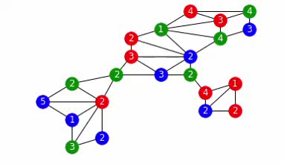
Random Agent Game Example

